Slide 1
Hotel Review Classification
Ankit Modak

Slide 2
Goals:
To understand the dataset.
To build a machine learning model which can predict if the review is : Positive, Negative or Neutral.
To get the words/attributes which influence the decision.
To deploy the model for public use.

Slide 3
Dataset
Contains 20000+ `Review` (comments for the hotel) and `Rating` (1-5)
There were no null values found in the dataset. No duplicate values were found. The hotel was majorly rated as 5.
Preprocessing
Defined some functions to preprocess the `Review` before we build a machine learning model. Functions defined were: convert_to_lower, remove_numbers, remove_punctuations, remove_stopwords, remove_extra_white_spaces
In the end, lemmetized the `Review` with lemmatizing function. The length of `Review` before and after preprocessing were different.

Slide 4
Sentiment analysis
Used Afinn library to do sentiment check.
Afinn checks the Review and compares the words with it’s own library.
It gives certain numeric value to the words. We can sum it up and check the sentiment of the Review.
Following are some functions used :
afn_score
sentiment_analysis
Gives Afinn score provided to the text.
Checks the score. If the score < 0 then `1` and if the score > 0 then `-1` otherwise `0`.

Slide 5
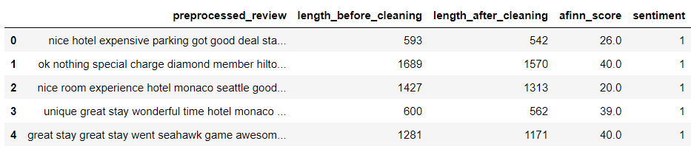
Data after preprocessing & Sentiment Analysis.

Slide 6
Model building and experimentation
TF-IDF vectorizer
Naïve Bayes
Converts the text into numbers/vector using term frequency and inverse document frequency.
Accuracy: 70% F1-score: -1 = 0.21 +1 = 0.82 0 = 0.03
Support vector classifier
Decision Tree
Accuracy: 95% F1-score: -1 = 0.55 +1 = 0.97 0 = 0.00
Accuracy: 91% F1-score: -1 = 0.44 +1 = 0.96 0 = 0.03

Slide 7
Experimentation
Selection
From the fitted models, we can see that the accuracy is very high, but the model isn’t predicting all the classes with maximum f1-score.
This is happening because our dataset has class imbalance. There are 18000+ positive reviews. Only 1200+ negative and 200+ neutral reviews.
We need to balance the data using dataset balancing techniques. e.g under-sampling, oversampling, etc
Tried under-sampling as well as oversampling, but the f1-score wasn’t increasing.
Tried augmentation to balance the dataset.

Slide 8
Augmentation
About
Augmentor is a Python package which artificially generates similar text for the text given.
Function
Defined `augmentMyData` function which automatically generated the Review with minority class.
Result
Due to lack of GPU and time, I down-sampled the positive reviews to 5000 and then did the augmentation.
Now we have: 1 : 5000 -1 : 2294 0 : 405

Slide 9
Model Building
Train Test Split
Splited the data into 9:1 ratio where 90 % of the observations were given to training and 10 % of the observations were left.
For test data, used earlier dataframe (without balancing)
Vectorizer
Used TF-IDF vectorizer to vectorize the Review.
Model
The training data is fitted to Decision Tree
Report
F1-score was considerably increased after balancing the dataframe.

Slide 10
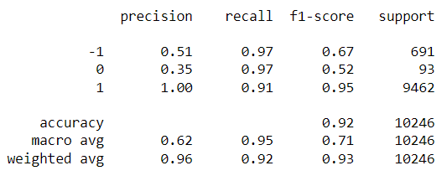
Reports
Accuracy
Classification Report
There is a slight increase in accuracy as well after balancing.
There is great increase in Precision, Recall and F1-score as well.
This model can classify the classes with great attributes than previous model.

Slide 11
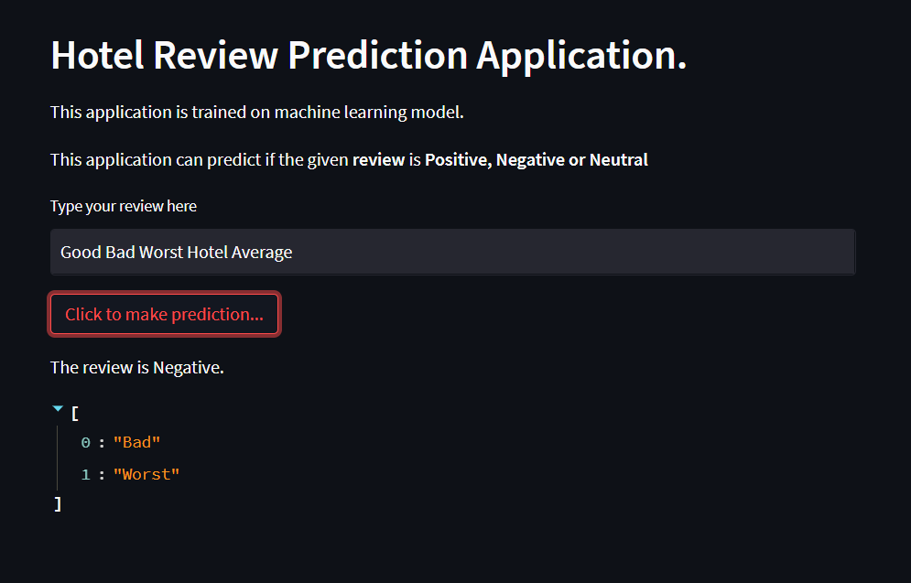
Deployment
app.py
Created a python file for deployment using `Streamlit`
EASY TO USE
The app can predict the Review given. Also, it gives the words influencing the sentiment of the Review given.

Slide 12
THANK YOU
Ankit Modak​
Ankitmodak05.am@gmail.com

